Slide 1
Modernizing SQL Server the Right Way
Post Migration Actions

Slide 2

Eduardo Pivaral
Experience
+15 Years of experience working on IT
+10 Years of experience working with SQL Server
Developer of Open Source tools for SQL Server administration, development and productivity.
Certifications
MCSE Data Management and Analytics
MCSA SQL 2016 Database Development
MCSA SQL 2016 Database Administration
MCSA SQL 2012/2014
MCSE Database Developer
www.sqlguatemala.com
Community
Regular Author for MSSQLTips.com
Regular Author for SQLServerCentral.com
MSSQLTips.com Rookie of the year 2018
Board member of Guatemala SQL Server User Group
Owner of SQLGuatemala.com
eduardo-pivaral
@EduardoDBA

Slide 3
Improvements since SQL Server 2008

Slide 4

How to justify the investment?
New features comparison from 2008/2008R2 to new versions
SQL Server 2019 (so far…)
Data virtualization
Big Data clusters
Machine Learning integration
Language Extensions for Java
Columnstore Index Enhancements
Resumable Online Index Creation
SQL Data Discovery and Classification
Always Encrypted with Secure Enclaves
UTF-8 Support
Enhancement in SQL Graph
Always on Improvements
Improved Intelligent Query Processing
SQL Server 2017
Support for Linux
Machine Learning Services
Resumable online index rebuild
Smart Backups
Improved Availability Groups
Improved In-Memory OLTP
Improved Security
New and improved DMO’s
Improved Query Store
Intelligent Query processing
SQL Server 2008/2008 R2
Language-Integrated Query
Transparent Failover (mirroring)*
Log Stream Compression (mirroring)*
Data Compression
FileStream Data
Master Data Services
*Will be removed on future product releases

Slide 5
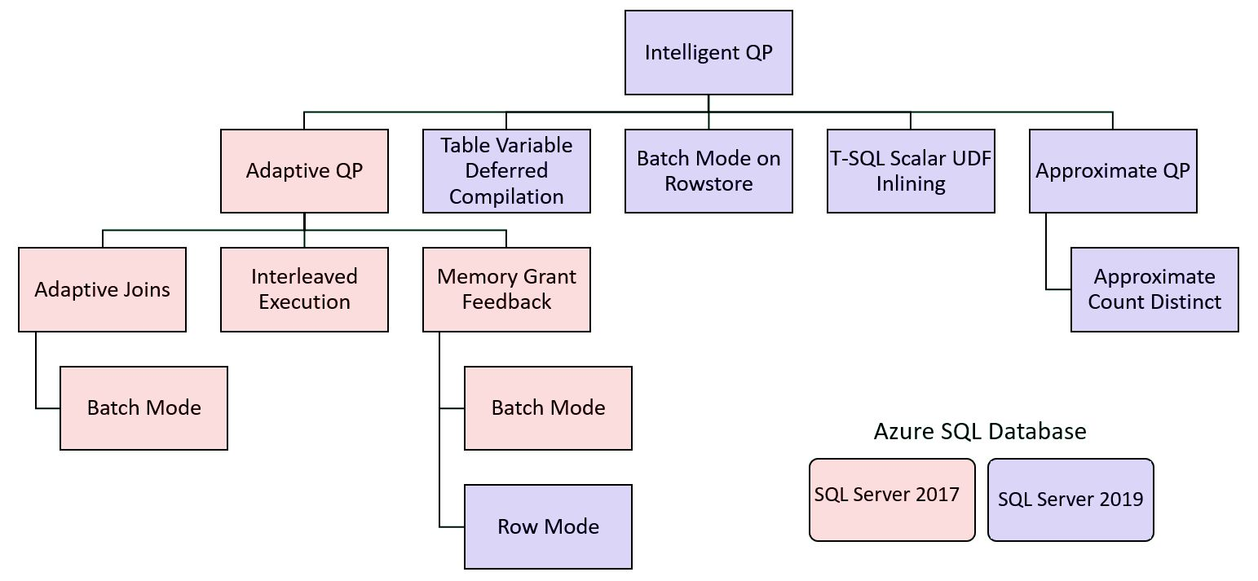
Intelligent Query processing
https://docs.microsoft.com/en-us/sql/relational-databases/performance/intelligent-query-processing?view=sql-server-2017

Slide 6
Intelligent Query processing
Check this article for an example on Memory Grant Feedback in SQL Server 2019:
https://www.mssqltips.com/sqlservertip/5793/sql-server-2019-memory-grant-feedback-example-and-data-collection/

Slide 7



Not just the SQL Server engine, but your tools…
SQL Server Management Studio 18.1 – A lot of new and improved features (and SQL Server 2019 support)
Download it here!
Azure Data Studio – Can be used on any operating system and focused on productivity and customization
Download it here!
Visual Studio 2019 and SSDT – Support for SQL Server 2019
Download it here!

Slide 8
Database Compatibility Certification

Slide 9
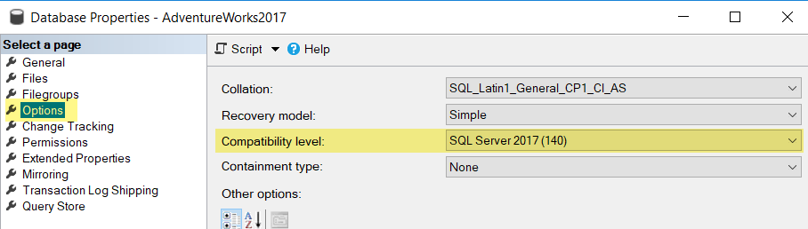
What is Database Compatibility level?
A method to maintain backward compatibility at database level into more recent versions of SQL Server
It Does NOT apply for Server level functionalities (for example DMOs)

Slide 10
Database Compatibility Level based certification
Stop certifying for any given platform (Cloud, on-prem)!
Stop certifying for a named SQL Server version!
Any certification process should be thought in terms of “which target database compatibility level am I certifying to?”
Updated public documentation: http://aka.ms/dbcompat
Notes:
We believe this paradigm shift unlocks agile modernization cycles and reduces upgrade risks.
And we are backing it up with actual engine level protections, as well as updated public documentation that moves in this direction: see http://aka.ms/dbcompat.

Slide 11
Key Benefits
Simplified application certification on-premise and Azure (e.g. Azure SQL DB MI).
Ability to provide customer a choice of latest SQL Server platform based on certified DB compat level.
Improved risk management by decoupling application upgrade cycles from Database upgrade cycles.

Slide 12
Microsoft stands by DB Compat based certification
Microsoft Database Compatibility Level Protection
Full Functional protection once assessment tools runs clean with no errors.
Query Plan shape protection on comparable hardware.
Maintaining backward compatibility is very important to SQL Server team.

Slide 13
Database Compatibility Level behavior
Database Compatibility Level sets certain database behaviors to be compatible with the specified version of SQL Server.
Product | Compatibility Level Designation | Supported Compatibility Levels
SQL Server 2019 | 150 | 150, 140, 130, 120, 110, 100
SQL Server 2017 | 140 | 140, 130, 120, 110, 100
Azure SQL Database | 130 | 150, 140, 130, 120, 110, 100
SQL Server 2016 | 130 | 130, 120, 110, 100
SQL Server 2014 | 120 | 120, 110, 100
SQL Server 2012 | 110 | 110, 100, 90
SQL Server 2008 R2 | 100 | 100, 90, 80
SQL Server 2008 | 100 | 100, 90, 80
SQL Server 2005 | 90 | 90, 80
SQL Server 2000 | 80 | 80
Compatibility level affects behaviors only for the specified database, not for the entire server.
Notes:
New Databases are set to compatibility level mapping to the version of the Database Engine, unless the model database has a lower compatibility level.
When a database is upgraded from any earlier version of SQL Server, the database retains its existing compatibility level if it is at least minimum allowed for that instance of SQL Server.
Upgrading a database with a compatibility level lower than the allowed level, sets the database to the lowest compatibility level allowed.
Azure SQL Database V12 was released in December 2014. One aspect of that release was that newly created databases had their compatibility level set to 120. In 2015 SQL Database began support for level 130, although the default remained 120.
Starting in mid-June 2016, in SQL Database, the default compatibility level are 130 instead of 120 for newly created databases. Existing databases created before mid-June 2016 are not affected, and maintain their current compatibility level (100, 110, or 120).
If you want level 130 for your database generally, but you have reason to prefer the level 110 cardinality estimation algorithm, see ALTER DATABASE SCOPED CONFIGURATION (Transact-SQL), and in particular its keyword LEGACY_CARDINALITY_ESTIMATION = ON.
For details about how to assess the performance differences of your most important queries, between two compatibility levels on SQL Database, see Improved Query Performance with Compatibility Level 130 in Azure SQL Database.

Slide 14
Functional change protection Clarifying the caveats
Deprecated = avoid use in new development
Deprecated functionality introduced in a given SQL Server version is still protected by that compatibility level.
Discontinued = removed from product
Discontinued functionality introduced in a given SQL Server version is not protected by compatibility level.
Notes:
© Microsoft Corporation. All rights reserved. MICROSOFT MAKES NO WARRANTIES, EXPRESS, IMPLIED OR STATUTORY, AS TO THE INFORMATION IN THIS PRESENTATION.

Slide 15
Example of removed T-SQL syntax.
In SQL Server 2012 the fastfirstrow hint was removed.
Regardless of the compatibility level, the query below will produce error 321 (not a recognized table hints option):
SELECT * FROM HumanResources.Employee WITH (FASTFIRSTROW);
--Instead use:
SELECT * FROM HumanResources.Employee OPTION (FAST = <n>);
Notes:
© Microsoft Corporation. All rights reserved. MICROSOFT MAKES NO WARRANTIES, EXPRESS, IMPLIED OR STATUTORY, AS TO THE INFORMATION IN THIS PRESENTATION.

Slide 16
Breaking Changes = behavior changes resulting in different outcome
Protected by Database Compatibility:
DECLARE @value datetime = '1900-01-01 00:00:00.003'
SELECT CAST(@value AS datetime2)
In DB Compat 120 or lower, result is: 1900-01-01 00:00:00.0030000
Under DB Compat 130, these show improved accuracy by accounting for the fractional milliseconds, resulting in: 1900-01-01 00:00:00.0033333
Not Protected by Database Compatibility:
The query below works until DB Compat 90, but errors out starting with Database Compatibility 100 (error 241, conversion fail): SELECT DATEPART (year, '2007/05-30’)
Instead use: SELECT DATEPART (year, '2007/05/30’) or SELECT DATEPART (year, '2007-05-30’)
Notes:
Until DB Compat 90, datetime intrinsics such as DATEPART do not require string input values to be valid datetime literals. For example, SELECT DATEPART (year, '2007/05-30') compiles successfully.
Starting with DB Compat 100, datetime intrinsics such as DATEPART require string input values to be valid datetime literals. Error 241 is returned when an invalid datetime literal is used.
© Microsoft Corporation. All rights reserved. MICROSOFT MAKES NO WARRANTIES, EXPRESS, IMPLIED OR STATUTORY, AS TO THE INFORMATION IN THIS PRESENTATION.

Slide 17
Check Microsoft Official documentation to see changes across different compatibility levels:
https://docs.microsoft.com/en-us/sql/t-sql/statements/alter-database-transact-sql-compatibility-level

Slide 18
Post-Migration

Slide 19
I moved the data, am I done?
SQL Server post migration step is very crucial for reconciling any data accuracy and completeness, as well as uncover performance issues with the workload.
Recommended Upgrade Plan for latest DB Compatibility Level:
Upgrade to latest SQL Server and keep source DB Compat level
Enable Query Store
Wait to collect data on the workload (create a baseline)
Set DB Compat Level to latest
Quickly fix regressions by forcing last known good plan
Notes:
Reference:
https://docs.microsoft.com/sql/relational-databases/performance/query-store-usage-scenarios#CEUpgrade

Slide 20
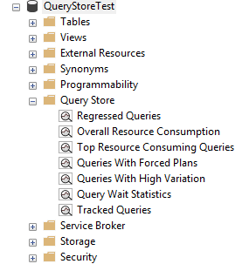
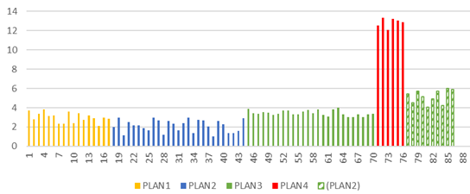
Upgrading DB Compat until recently
SQL 2016+
Query Store Regressed Queries
SQL 2017+
Automatic Plan Correction
Notes:
Identifies the problem query plan and “fixes” it to be optimal. In the scope of a DB Compatibility upgrade, only works if the recommended process was followed

Slide 21
-- Enabling Query Store (starting SQL Server 2016)
ALTER DATABASE [YourDatabase] SET QUERY_STORE = ON;
-- Enabling Automatic tuning (starting SQL Server 2017)
ALTER DATABASE [YourDatabase] SET AUTOMATIC_TUNING ( FORCE_LAST_GOOD_PLAN = ON );
More info about Query Store here:
https://www.sqlservercentral.com/steps/the-basics-level-1-of-the-stairway-to-query-store

Slide 22
Query Tuning Assistant (QTA)
1st Priority: to guide users through the documented and recommended DB Compatibility upgrade procedure with ease.
What if instead of choosing between current and last know good plan, we find a 3rd, better plan?
Upgrade to latest SQL Server and keep source DB Compat level
Enable Query Store
Wait to collect data on the workload (create a baseline)
Set DB Compat Level to latest
Quickly fix regressions by forcing last known good plan
Find a better plan through tuning
Notes:
Post-migration/upgrade
Crucial to uncover query performance issues with the workload, as it runs on the newer version of SQL Server Database Engine.
User needs to follow documented DB upgrade procedure (https://docs.microsoft.com/en-us/sql/relational-databases/performance/query-store-usage-scenarios#CEUpgrade).
User database is still in before-upgrade database compatibility level, and QTA will assist in collecting baseline workload data (if none available), bump database compatibility level, collect 2nd pass of workload data, and work on any regressions found based on “Regressed Queries” QS report.

Slide 23
Documented DB Compatibility upgrade process:
https://docs.microsoft.com/en-us/sql/relational-databases/performance/query-store-usage-scenarios?view=sql-server-2017#CEUpgrade
Notes:
Post-migration/upgrade
Crucial to uncover query performance issues with the workload, as it runs on the newer version of SQL Server Database Engine.
User needs to follow documented DB upgrade procedure (https://docs.microsoft.com/en-us/sql/relational-databases/performance/query-store-usage-scenarios#CEUpgrade).
User database is still in before-upgrade database compatibility level, and QTA will assist in collecting baseline workload data (if none available), bump database compatibility level, collect 2nd pass of workload data, and work on any regressions found based on “Regressed Queries” QS report.

Slide 24
Query Tuning Assistant (QTA) Workflow
Query Store Regressed Queries
Analysis and Recommendations
Correlation vs Independence ASSUME_MIN_SELECTIVITY_FOR_FILTER_ESTIMATES
Deployment via Plan Guide
As a last resort, full-fledge use of CE70 is also considered, when all else doesn’t yield desired results.
Simple vs Base Join Containment ASSUME_JOIN_PREDICATE_DEPENDS_ON_FILTERS
TVF fixed estimation of 100 rows vs 1 row ‘QUERYTRACEON 9488’
Available in SSMS v18 and Powershell (preview)
Notes:
Like any hint, it forces certain behaviors that may get addressed in subsequent updates. So Microsoft recommends you only apply hints when no other option exists, and plan to revisit hinted code with every new upgrade. By forcing behaviors, you may be precluding your workload from benefiting of enhancements introduced in newer versions.

Slide 25
Query Tuning Assistant (QTA)
Official documentation:
https://docs.microsoft.com/en-us/sql/relational-databases/performance/upgrade-dbcompat-using-qta?view=sql-server-2017
Notes:
Like any hint, it forces certain behaviors that may get addressed in subsequent updates. So Microsoft recommends you only apply hints when no other option exists, and plan to revisit hinted code with every new upgrade. By forcing behaviors, you may be precluding your workload from benefiting of enhancements introduced in newer versions.

Slide 26
DEMO
Query Tuning Assistant

Slide 27
Modernization Tools Breakdown
QTA
Upgrade Database Compatibility Model to desired state
Provides tangible recommendations for tuning queries without reverting DB compat
DMA
A/B Testing
Capture and Replay workload for performance testing and reporting
Also reports on migration blockers because of failed T-SQL syntax
Detects workload regressions, and tests CE model variations (subsets)
Readiness assessment: blocking issues breaking changes, behavior changes
Moves schema, data and uncontained objects (like logins) To Azure SQL Database
Backup / Restore to another SQL Server (Keeps source DB Compatibility Level)
DEA
New feature recommendation
Notes:
DMA
https://docs.microsoft.com/en-us/sql/dma/dma-assesssqlonprem
https://docs.microsoft.com/en-us/sql/dma/dma-overview
New feature recommendations include In-Memory OLTP and Columnstore, Stretch Database, Always Encrypted, Dynamic Data Masking, and Transparent Data Encryption.
DEA
Database Experimentation Assistant (DEA) is an A/B testing solution for changes in SQL Server environments (e.g. upgrade, new indexes, etc.). It assists in evaluating how the workload on your source server (current environment) will perform against your new environment. It guides you through performing an A/B test through three steps: capture, replay, and analysis.
QTA
Query Tuning Assistant (QTA) helps address some of the most common causes of CE-related performance regression, namely the following model assumption changes, starting with SQL Server 2014:
Independence vs Correlation
Simple Containment vs Base Containment
TVF fixed estimation of 100 rows vs 1 row
Note: as a last resort, full-fledge use of CE 70 is also considered, when all else doesn’t yield desired results.
This is done by attempting to use targeted USE HINT query hints that change these assumptions, for regressed SELECT-based queries.

Slide 28
Session takeaways
Start planning for End of Service for SQL Server 2008/R2 and Windows Server 2008/R2 today!
Review the database migration guide
Familiarize yourself with the DMA, DEA, Query Store and Query Tuning Assistant
Leverage Database Compatibility to accelerate modernization

Slide 29
Session resources
http://aka.ms/sqleosfaq - End-of-Support FAQ
Upgrade SQL Server
Database Migration Guide
Microsoft Assessment and Planning Toolkit
Overview of Data Migration Assistant
DEA 2.1 General Availability: Release Overview – Database Experimentation Assistant
Post-migration Validation and Optimization Guide
http://aka.ms/dbcompat (DB Compatibility Level based upgrades)

Slide 30
Questions?

Slide 31



Thank you!
Want to know more? Having doubts about this presentation?
Visit me at:
www.SQLGuatemala.com
Eduardo Pivaral
@EduardoDBA
Epivaral

